Slide 1
Representation:
Feature Engineering
Hongyu Guo
2024 Winter

Slide 2
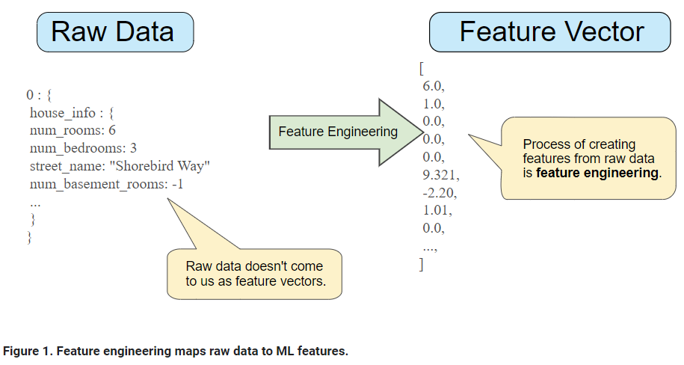
Mapping Raw Data to Features
Feature engineering means transforming raw data into a feature vector.

Slide 3
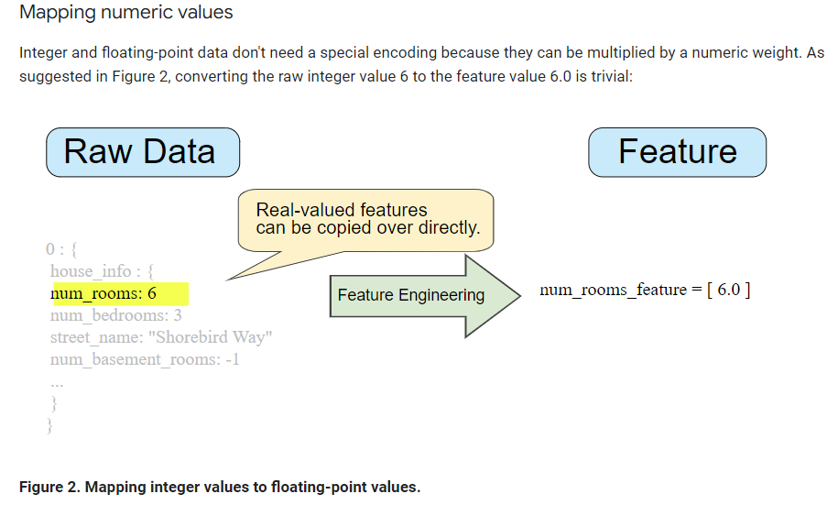

Slide 4
Mapping categorical values
Categorical features have a discrete set of possible values.
    'Charleston Road', 'North Shoreline Boulevard', 'Shorebird Way', 'Rengstorff Avenue’}
Since models cannot multiply strings by the learned weights, we use feature engineering to convert strings to numeric values.
One – hot encoding
    For values that apply to the example, set corresponding vector elements to 1.
    Set all other elements to 0.
  One-hot encoding extends to numeric data that you do not want to directly multiply by a weight, such as a postal code.

Slide 5
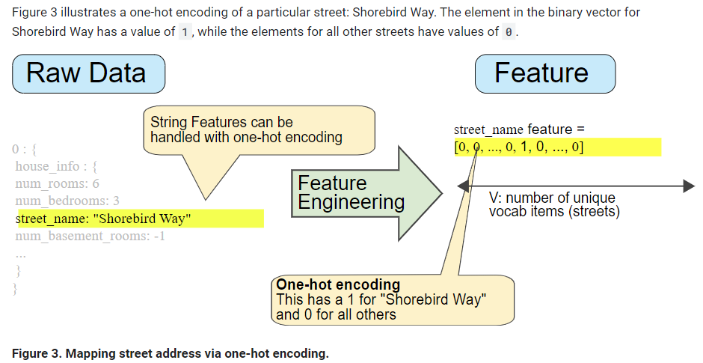
One – hot encoding

Slide 6
Sparse Representation
Suppose that you had 1,000,000 different street names in your data set that you wanted to include as values for street_name.
Explicitly creating a binary vector of 1,000,000 elements where only 1 or 2 elements are true is a very inefficient representation in terms of both storage and computation time when processing these vectors.
In this situation, a common approach is to use a sparse representation in which only nonzero values are stored.

Slide 7
Scaling feature values
Scaling means converting floating-point feature values from their natural range (for example, 100 to 900) into a standard range (for example, 0 to 1 or -1 to +1).
  Helps gradient descent converge more quickly.
  Helps the model learn appropriate weights for each feature. Without feature scaling, the model will pay too much attention to the features having a wider range.

Slide 8
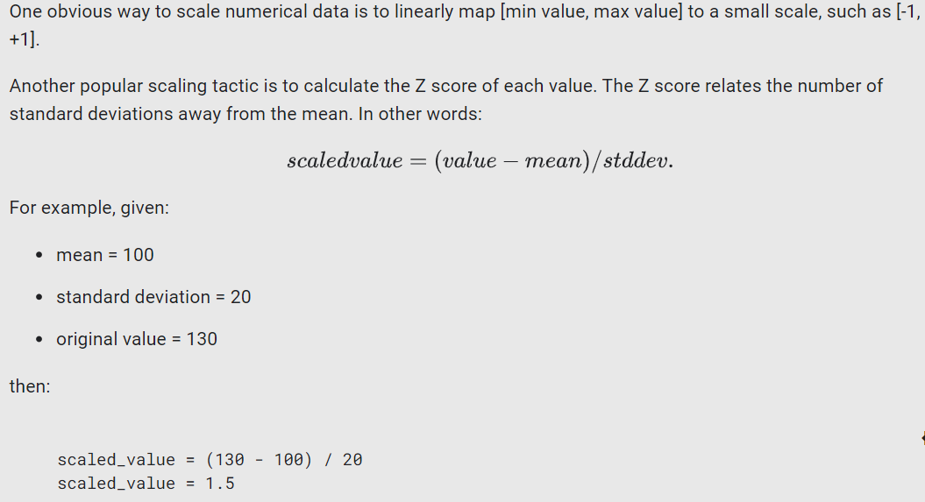

Slide 9
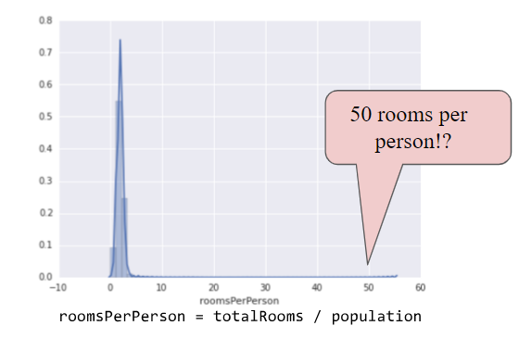
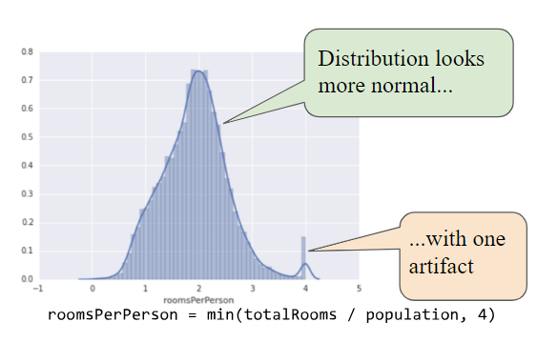
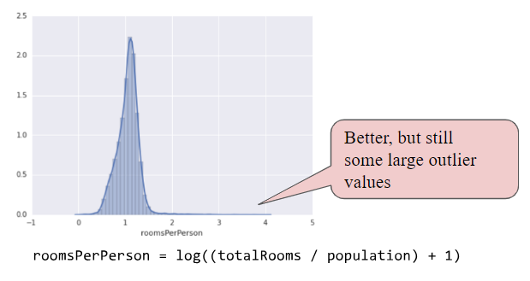
Handling extreme outliers
Logarithmic scaling
Clipping feature values

